Slide 1
Content Prepared by
Ms. C. SASIKALA
Assistant Professor,
Department of English,
Jamal Mohamed College,
Trichy – 620 020.

Slide 2
POETRY AND ONE ACT PLAYS

Slide 3
UNIT-I
1. The Road Not Taken
- Robert Frost

Slide 4
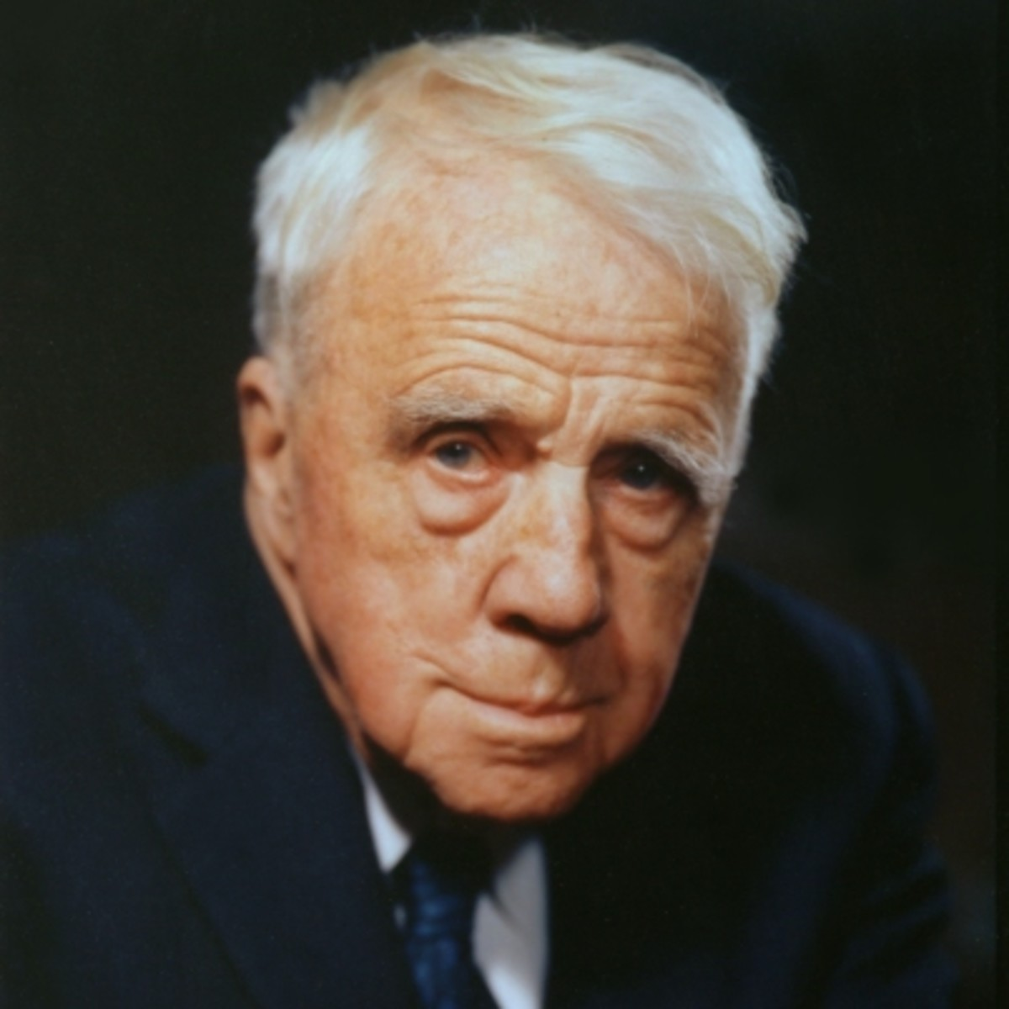

Slide 5
Agenda
Author’s Introduction
Title of the poem
Theme of the poem
About the poem
Poem
Rhyme scheme of the poem
Line by line explanation
Moral of the poem

Slide 6
Author’s Introduction:
Author’s full name was Robert Lee Frost. He was born on (1874-1963) USA. He was an American poet. His other career are Teacher, Farmer, Playwright and editor. He was much admired for his depictions of the rural life of New England. His first achieved professional publication in 1894 when The Independent, a weekly literary journal, printed his poem “My Butterfly: An Elegy.”

Slide 7
HIS IMPACT OF THE WORLD
While Robert Frost was an American author, his impact can clearly be seen all over the world. Frost focused his writings on the beauty of life and of nature. While Frost's language is simple, it is also very profound. Frost spoke of everyday events, common situations, and rural imagery.
THEME OF HIS POETRY
The main theme of his poetry is the despairing state of man in his life. In all of Frost's works, the reader sees encapsulated in verse, a depth and level of human emotion that is not easily discerned by the eye, but rather felt and nurtured in the heart

Slide 8
HIS INSPIRED PEOPLE
Frost met and was influenced by such contemporary British poets as Edward Thomas, Rupert Brooke, and Robert Graves. While in England, Frost also established a friendship with the poet Ezra Pound, who helped to promote and publish his work.
USING NATURE IN HIS POEM
Frost uses nature as a metaphor, primarily, in his poems to express the intentions of his poems. He uses nature as a background metaphor in which he usually begins a poem with an observation of something in nature and then moves towards a connection to some human situation.

Slide 9
TITLE OF THE POEM
The title "The Road Not Taken" focuses the poem on lost opportunities – the road that the speaker did not take. More than anything in the text of the poem, this title hints that the poem is about lost opportunities, and the complexities of choices, not just choosing the path that is fresh and new.

Slide 10
THEME OF THE POEM
It's actually a poem about the journey of life. The two roads diverged in a yellow wood symbolize a person's life. The main theme of "The Road Not Taken" is that life is full of choices which will define our destinies. The speaker spends a while deliberating when he comes to a fork in the road, which symbolizes a choice he must make in his life

Slide 11
ABOUT THE POEM
In the poem - ‘The Road Not Taken’, the road symbolizes our life. The poet says that the path that we don’t choose in our life is ‘the road not taken’. He describes his feelings about that choice that he had left in the past. The path which we have chosen, decides our future, our destination. The important message that the poet wants to give is that the choice that we make has an impact on our future and if we make a wrong choice, we regret it but cannot go back on it. So, we must be wise while making choices.

Slide 12


Slide 13
The Road Not Taken
Two roads diverged in a yellow wood,
And sorry I could not travel both
And be one traveler, long I stood
And looked down one as far as I could
To where it bent in the undergrowth;
Then took the other, as just as fair,
And having perhaps the better claim,
Because it was grassy and wanted wear;
Though as for that the passing there
Had worn them really about the same,

Slide 14
And both that morning equally lay
In leaves no step had trodden black.
Oh, I kept the first for another day!
Yet knowing how way leads on to way,
I doubted if I should ever come back.
I shall be telling this with a sigh
Somewhere ages and ages hence:
Two roads diverged in a wood, and I—
I took the one less traveled by,
And that has made all the difference.

Slide 15
RHYME SCHEME OF THE POEM
The poem, having a perfect rhyme scheme, 'ABAAB' is an ambiguous poem that allows the readers to think about choices they make in life.

Slide 16
Explanation of the poem
“Two roads diverged in a yellow wood
And sorry I could not travel both “
The poet has come into the deep autumnal wood where two roads have diverged into two ways like a fork .Immediately the poet understands that as a traveler travelling both the roads is impossible. Here two roads are meant two ways of life. Yellow wood symbolizes the autumnal forest.

Slide 17
And be one traveler, long I stood
And looked down one as far as I could
To where it bent in the undergrowth;”
The poet in utter state of duality examines both the roads as he finds himself in dilemma about the choice of roads.
At first he looked down the first road to the utmost to check whether it will be suitable or not.
Around the bend, the undergrowth (small plants and grass) block his view.
Then took the other, as just as fair,
After he has looked down the road for a long time, the speaker chooses to take the other path.
He means the road is just as nice as the other one

Slide 18
And having perhaps the better claim,
Because it was grassy and wanted wear;
As he is not sure, he feels it is only "perhaps" better.
The poet then found the other road to have better prospect because he found the other road to be less travelled and grassy one.
Though as for that the passing there
Had worn them really about the same,
"As for that" refers to the other path.
"The passing there" refers to the people passing along that road, probably on foot just like our speaker,
The speaker says that the people passing on the other path may have worn it down just as much as the path he had taken.

Slide 19
And both that morning equally lay
In leaves no step had trodden black
It is morning time. Hence the speaker is the probably among the first to travel on these paths on that day. The paths are covered with leaves, which haven't been turned black by steps crushing them.
Oh, I kept the first for another day!
The speaker seems to now regret his decision of choosing the other path.
Is he now justifying his choice of path by saying he'll come back to the one he missed later?
This is how people deal with difficult choices; They say "We can always come back and try the other option after,"

Slide 20
Yet knowing how way leads on to way,
I doubted if I should ever come back.
The speaker agrees that his hopes to come back and try the other path may not really be practical.
He says how "way leads on to way" – how one road can lead to another, and then another. Then one ends up very far from where you started.
That is why he doesn't think he'll ever be able to come back and take that other path.

Slide 21
I shall be telling this with a sigh
Somewhere ages and ages hence:
So the speaker is probably talking of years, not months.
The speaker says that he will still be telling about this decision many years later.
He'll be telling it with a sigh, though, which is interesting because sighs can be happy, sad, or merely reflective – and we don't know what kind of sigh this is.
So, we know that this choice is probably going to be important for the speaker's future, but he doesn’t know as of now if he's going to be happy about it or not.

Slide 22
Two roads diverged in a wood, and I—
This repetition helps to bring the poem to a conclusion.
It reminds us what's important in the poem – the concept of choosing between two different paths.
The hesitation of "and I" and the dash makes the end interesting.
This lets us know that whatever the speaker is about to say next is important.

Slide 23
I took the one less traveled by,
In this line, the speaker sums up his story and tells us that he took the road less traveled by.
With the hesitation in the line before, this declaration could be either triumphant – or regretful.
Also, remember it wasn't exactly clear that the road our speaker took was the one that was less traveled.
He said at first that it looked less worn, but then that the two roads were actually about equal.

Slide 24
And that has made all the difference.
The narrator took the path that no one else did, and that is what has made the difference in his life - that made him successful.
A "difference" could mean success, or utter failure.
From where he is now, just looking down the path as far as he can see, he can't tell the future
He can’t say if it leads him to good or bad.
He just knows that his choice is important – that it will make all the difference in his life.

